Slide 1
Aimless Travel
Stephen Dickey | Rotimi Amao | Ellyse Carter

Slide 2
ELEVATOR PITCH
Notes:
There are so many places to travel and things to see! How do you decide? Take this simple quiz to find out where you should go next

Slide 3
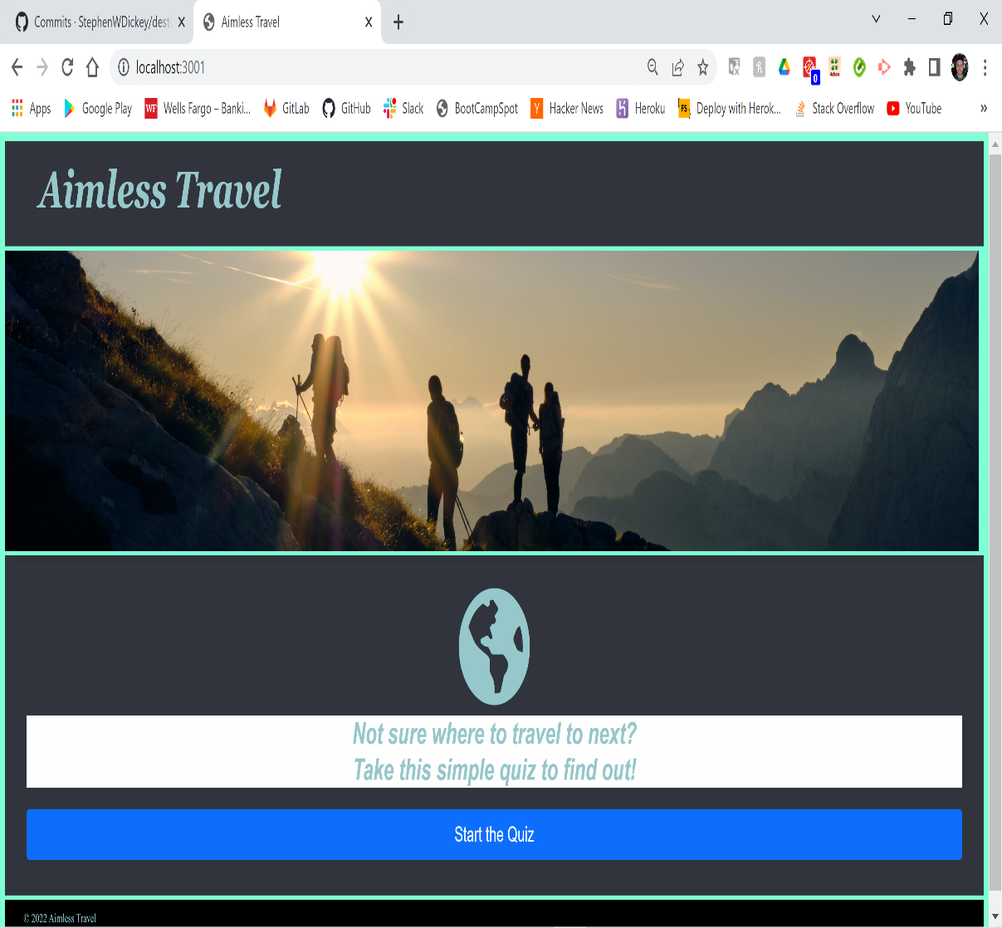
Description
Aimless Travel is a website that helps you choose where you should travel to next, based on answers to questions about your interests.
Answer 5 simple questions, then we will choose your next destination.
It's that simple!!
Notes:
May require more than one slide

Slide 4
motivation
Convenience!
There are so many places to visit and sometimes it can be hard to figure out where to go!
What kind of food do they eat? What language do they speak? Where will you stay while you're there?
So many variables and so many options. Our app can help you choose where to vacation.

Slide 5
User story
AS A
I WANT
SO THAT
person who likes to travel
an app that helps me choose where to go next
I can go to countries that suit my interests

Slide 6



Project Team Roles and Responsibilities
Stephen
Databases, Javascript, SQL, Models, seeds, Handlebars, Powerpoint -
Rotimi
Styling Handlebars -
Handlebars CSS Powerpoint Readme -
Ellyse

Slide 7
Technologies Used
FRONT END
HTML
CSS
Javascript
API
Bootstrap
Session Storage
BACK END
Handlebars
NPM
User Authentication
Bootstrap
Node Packages used:
sequelize, express, express-session, express-handlebars, dotnev, path, connect-session-sequelize, mysql2, bcrypt
Notes:
May require more than one slide

Slide 8
Team Practices
CHALLENGES
Work
Deaths in family
Surgery
Out of town
Merge conflicts with repo
SUCCESSES
Great teamwork despite our challenges
Found time to meet outside of class
Good communication
Grace with fellow team members and personal challenges
Good breakdown of tasks

Slide 9
Concept Development Backend Development Frontend Development
Notes:
Wecame up with an idea to include traveling. We did some research and found some websites where you can take a quiz and they can suggest destinations.
Stephen built the entire backend and got our servers running.
Ellyse did framework for handlebars and css
Rotimi perfected the styling and handlebars.
Stephen built the quiz functionality.

Slide 10
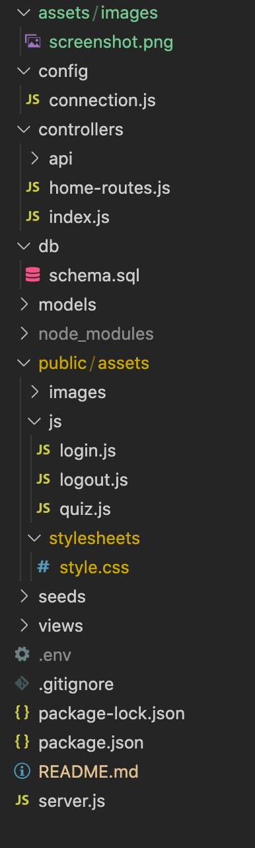
File Structure

Slide 11
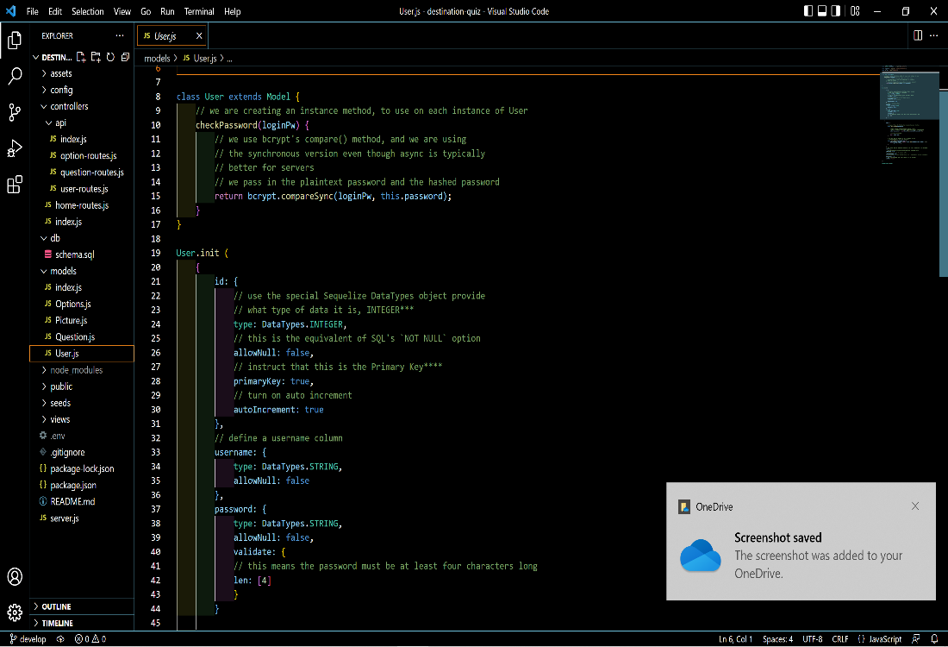
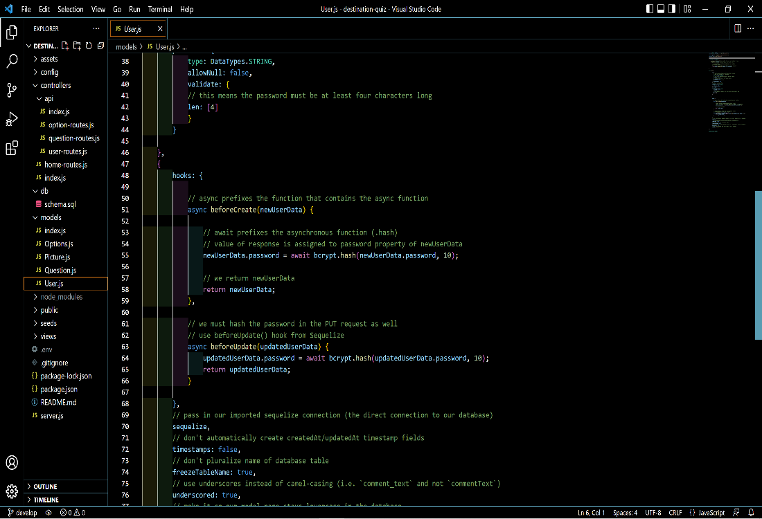
Models - User

Slide 12
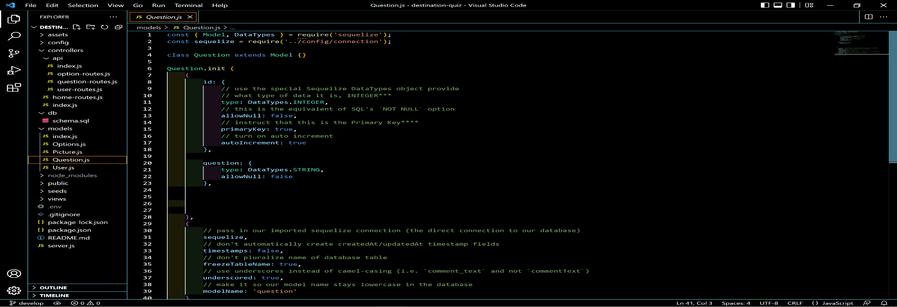
Models - Question

Slide 13
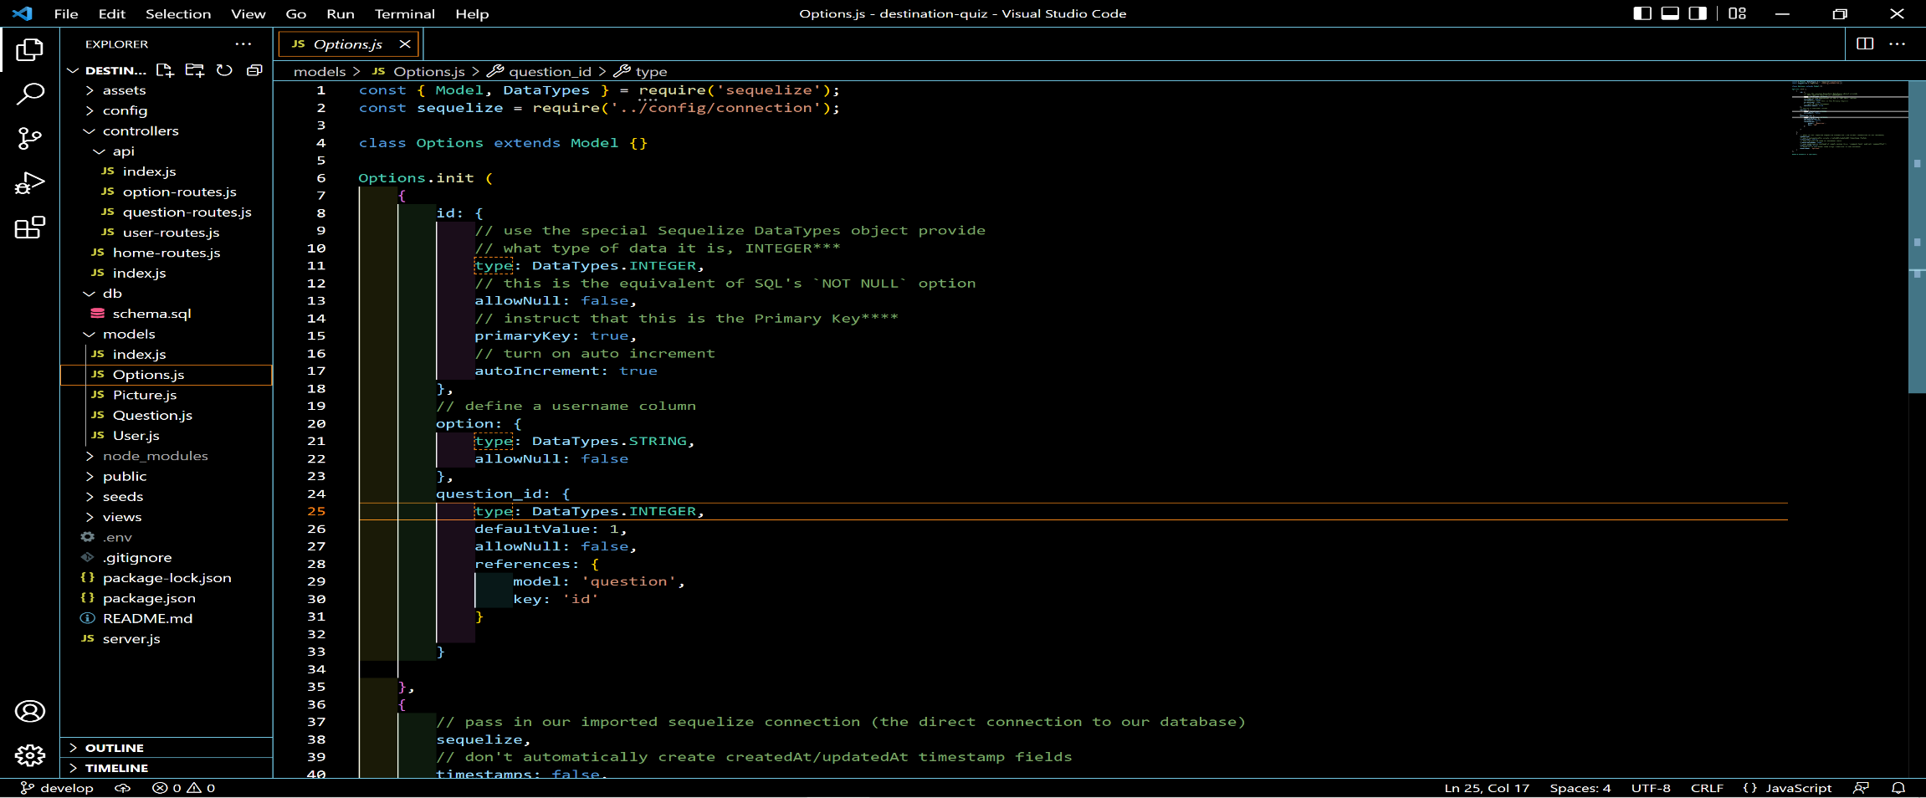
Models - Options

Slide 14
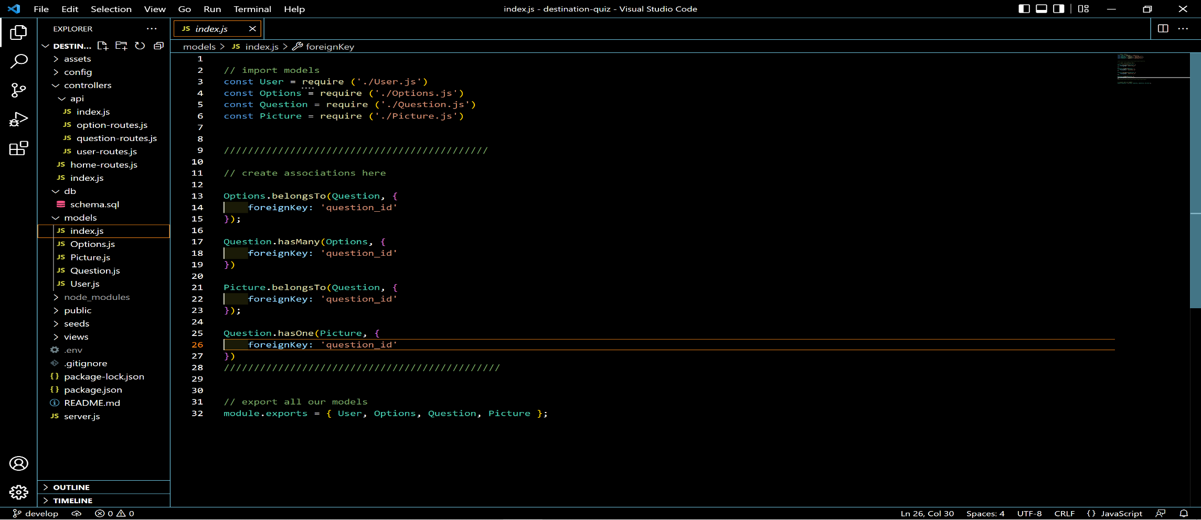
Models - Relations

Slide 15
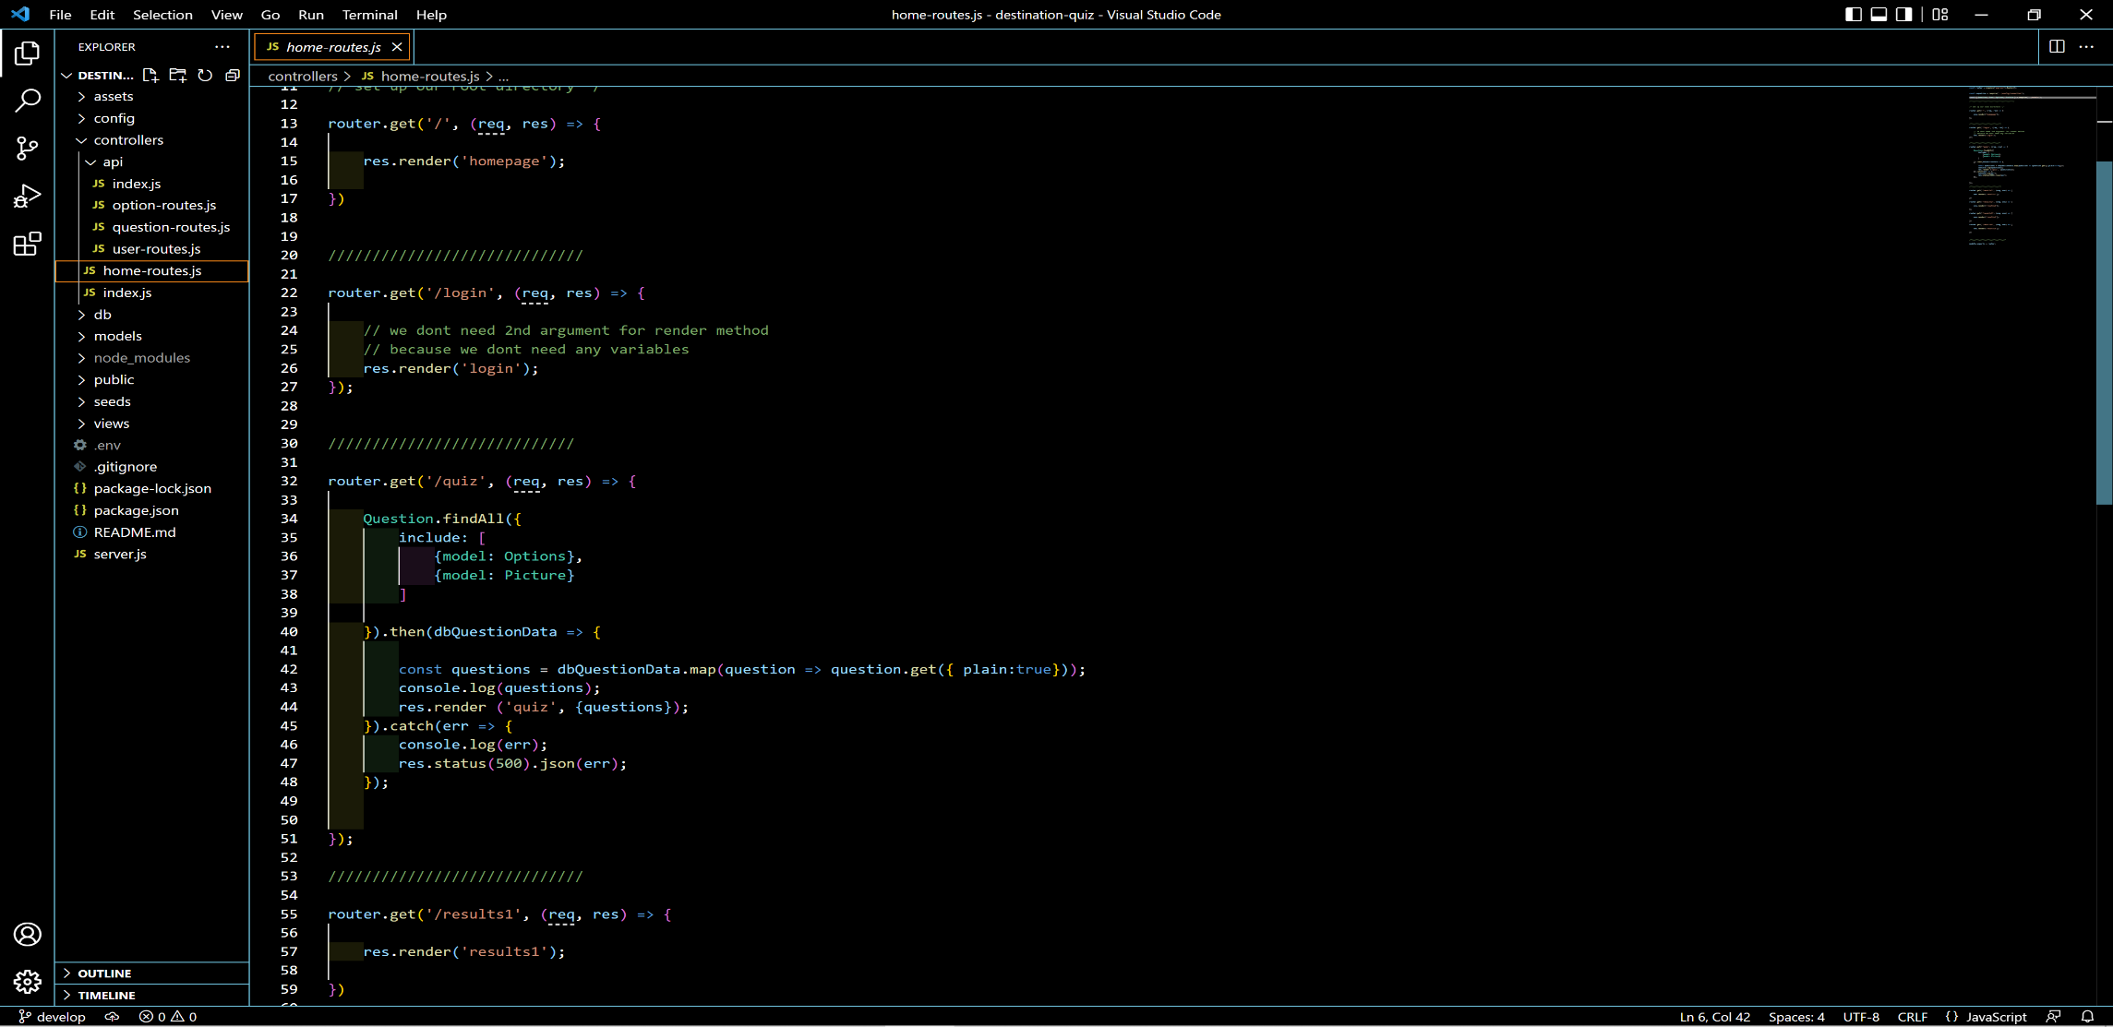
API – Home Routes

Slide 16
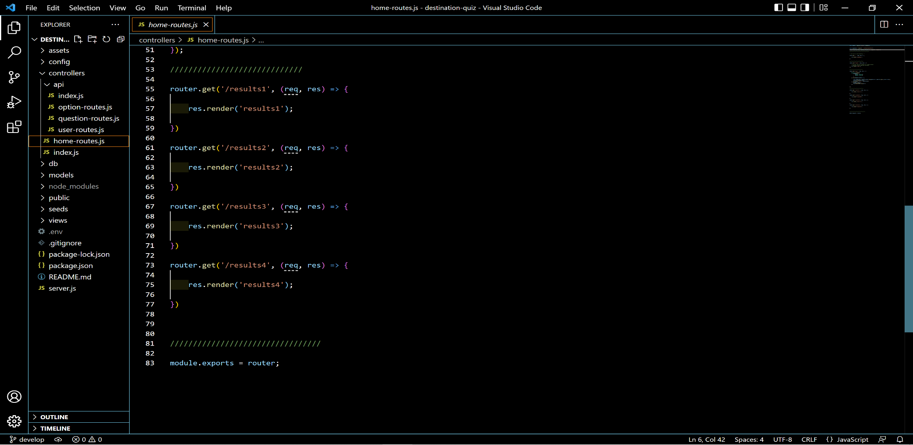
API – Home Routes cont.

Slide 17
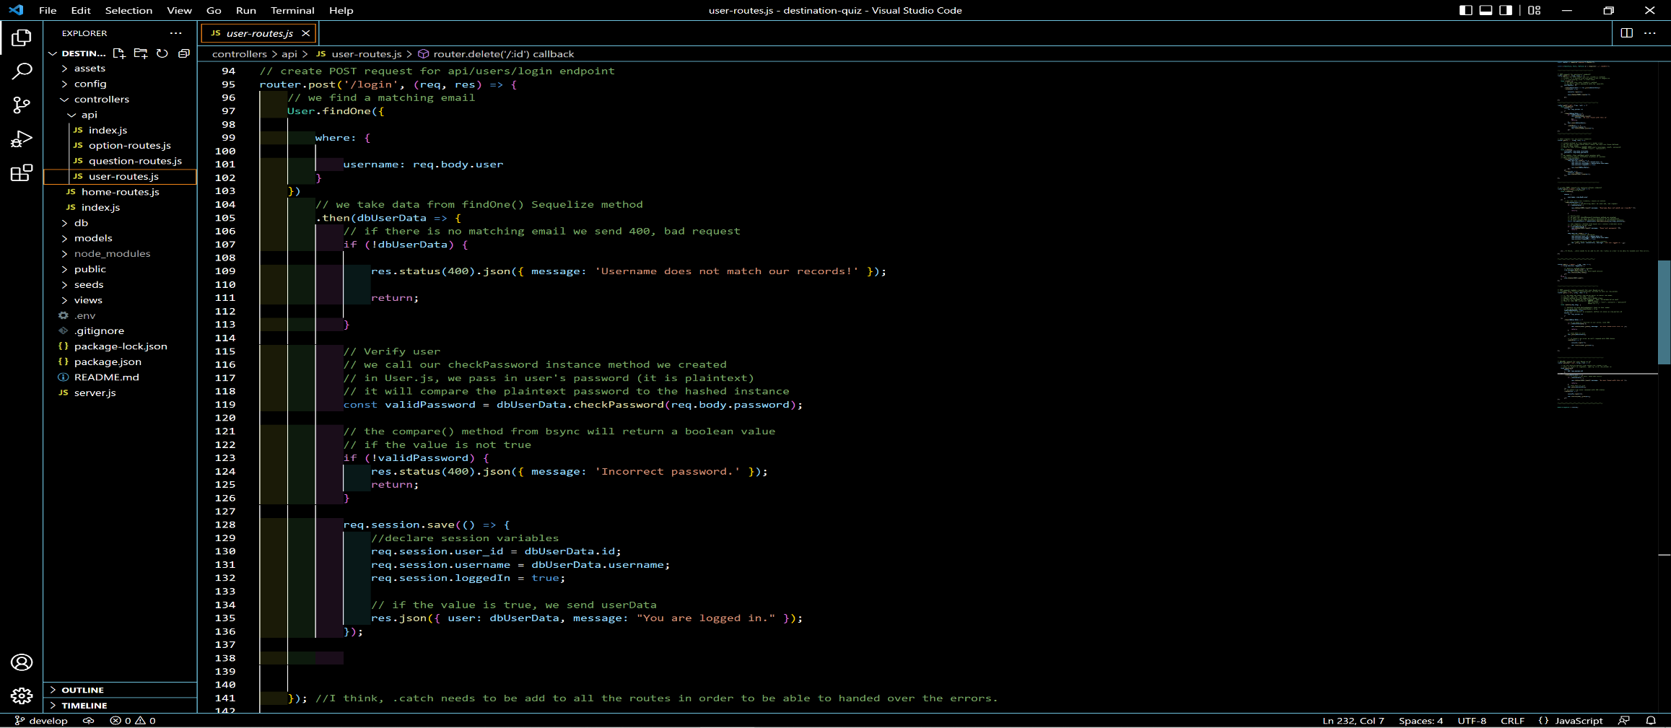
API – Users/Login

Slide 18
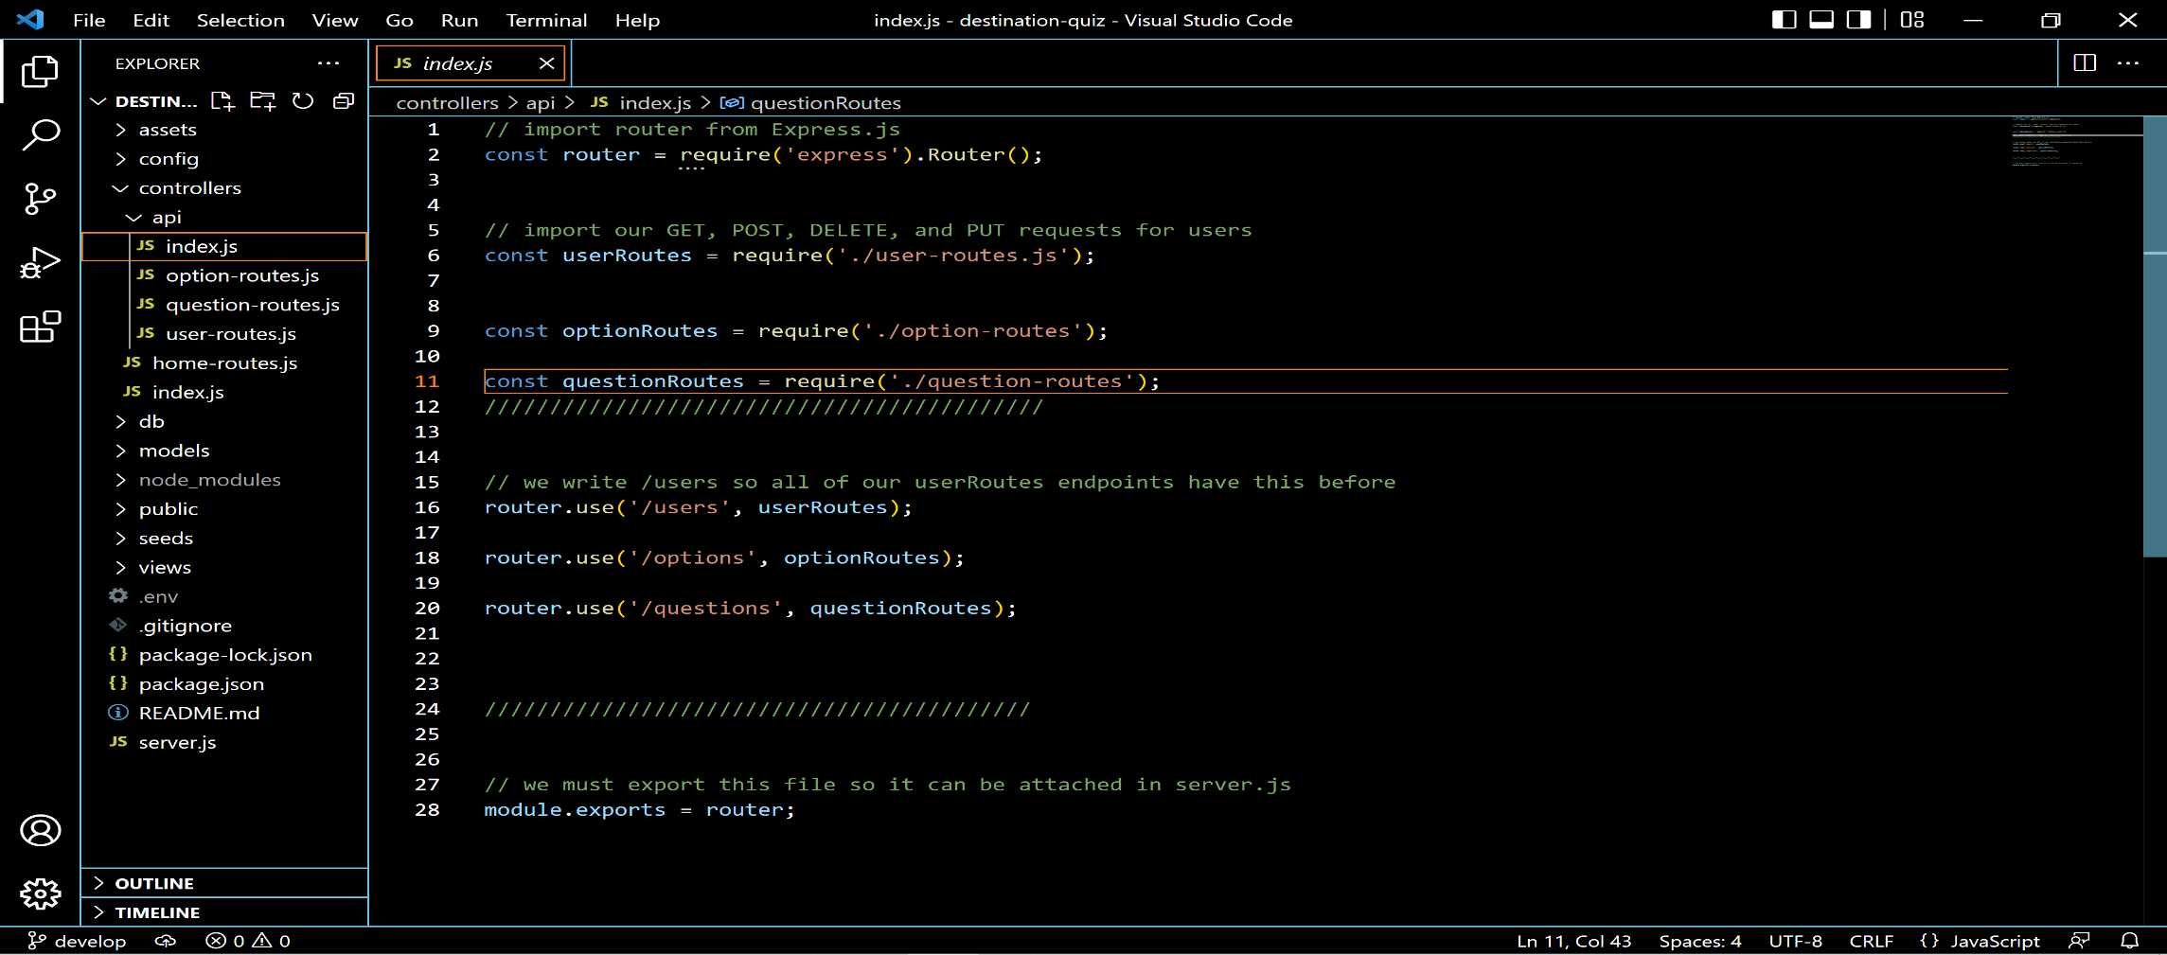
API - Index

Slide 19
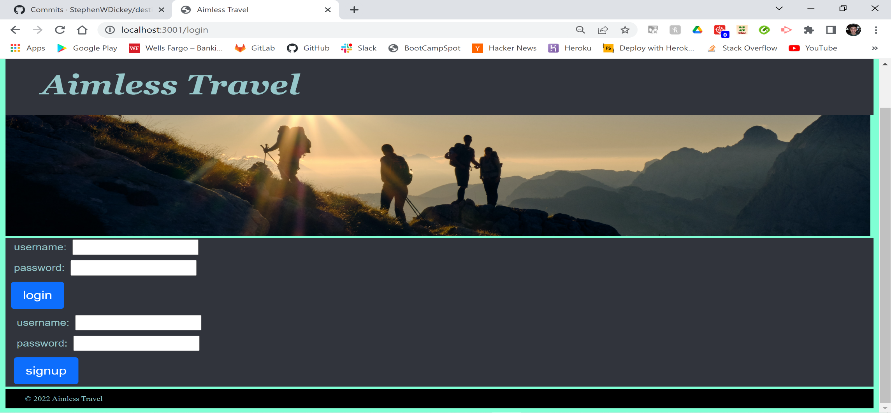
API – JSON Objects

Slide 20
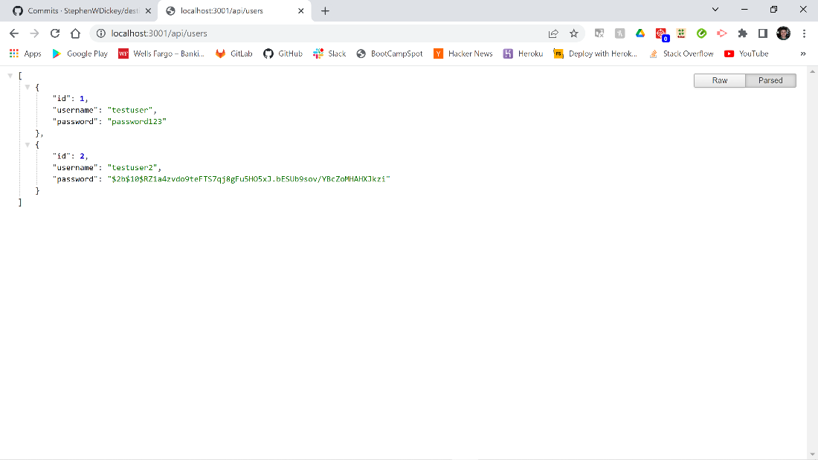
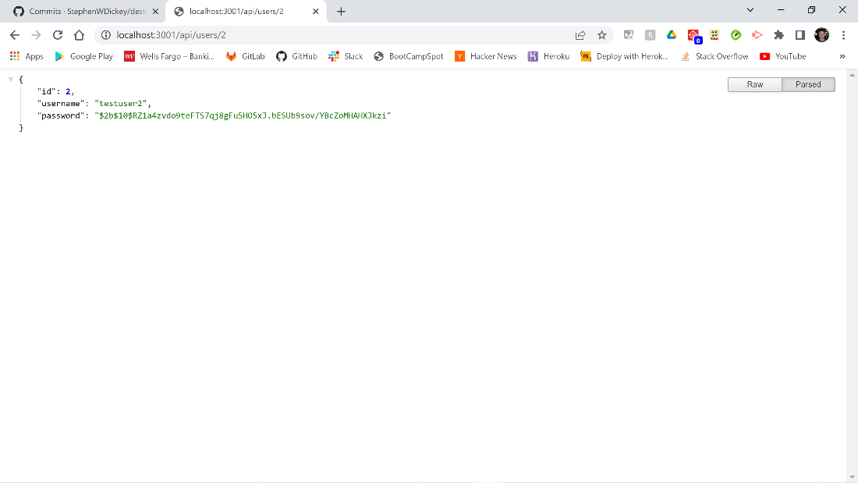
API – JSON Objects

Slide 21
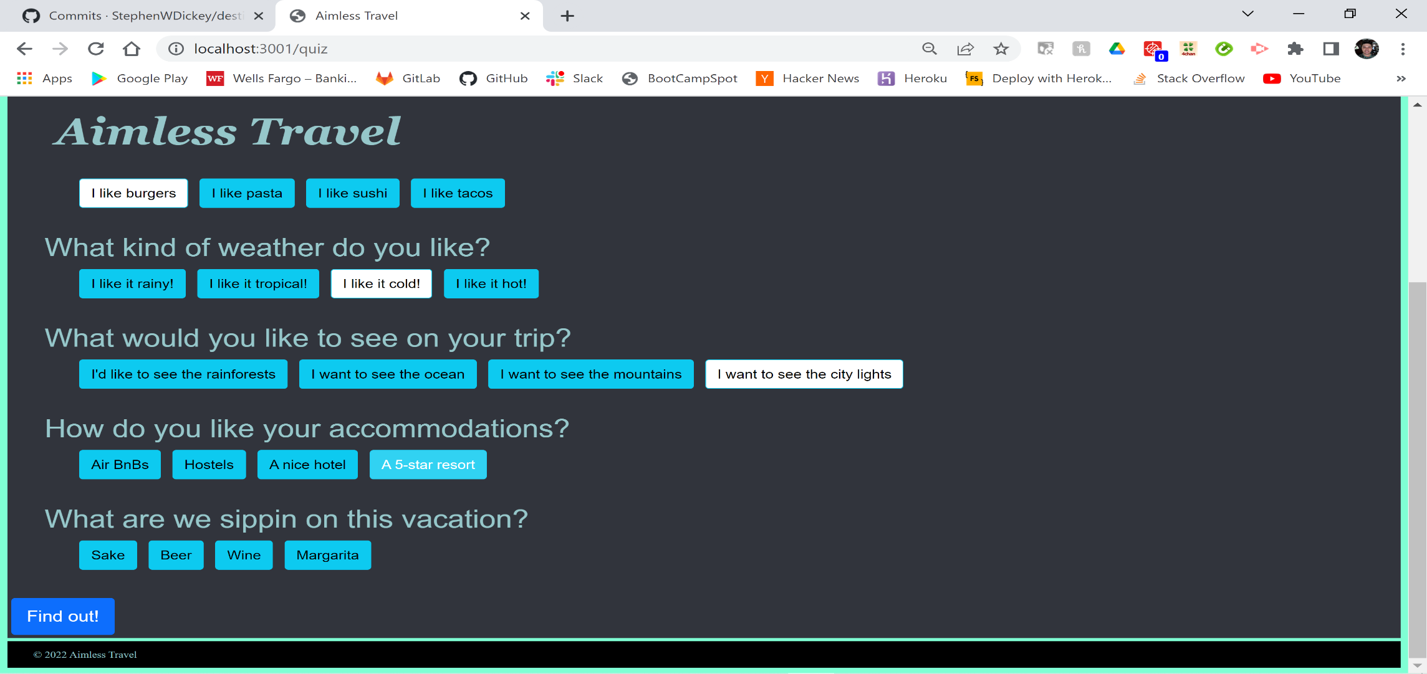
Feature - Quiz

Slide 22
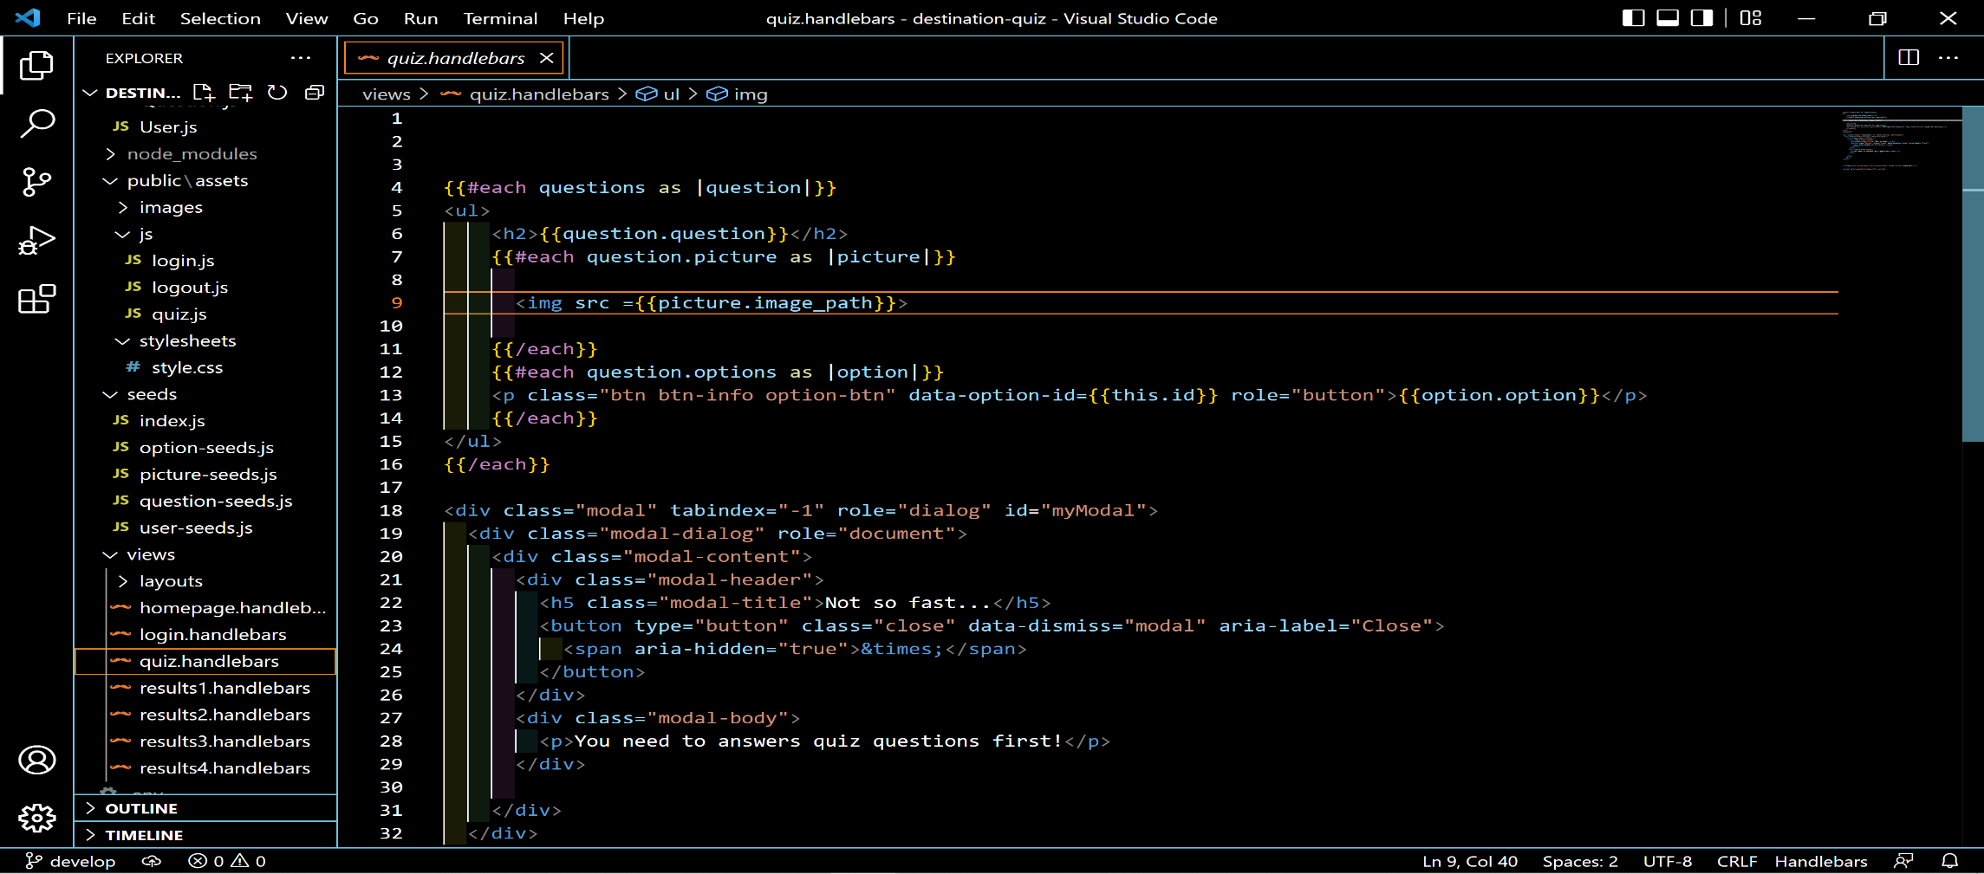
Code Highlights

Slide 23
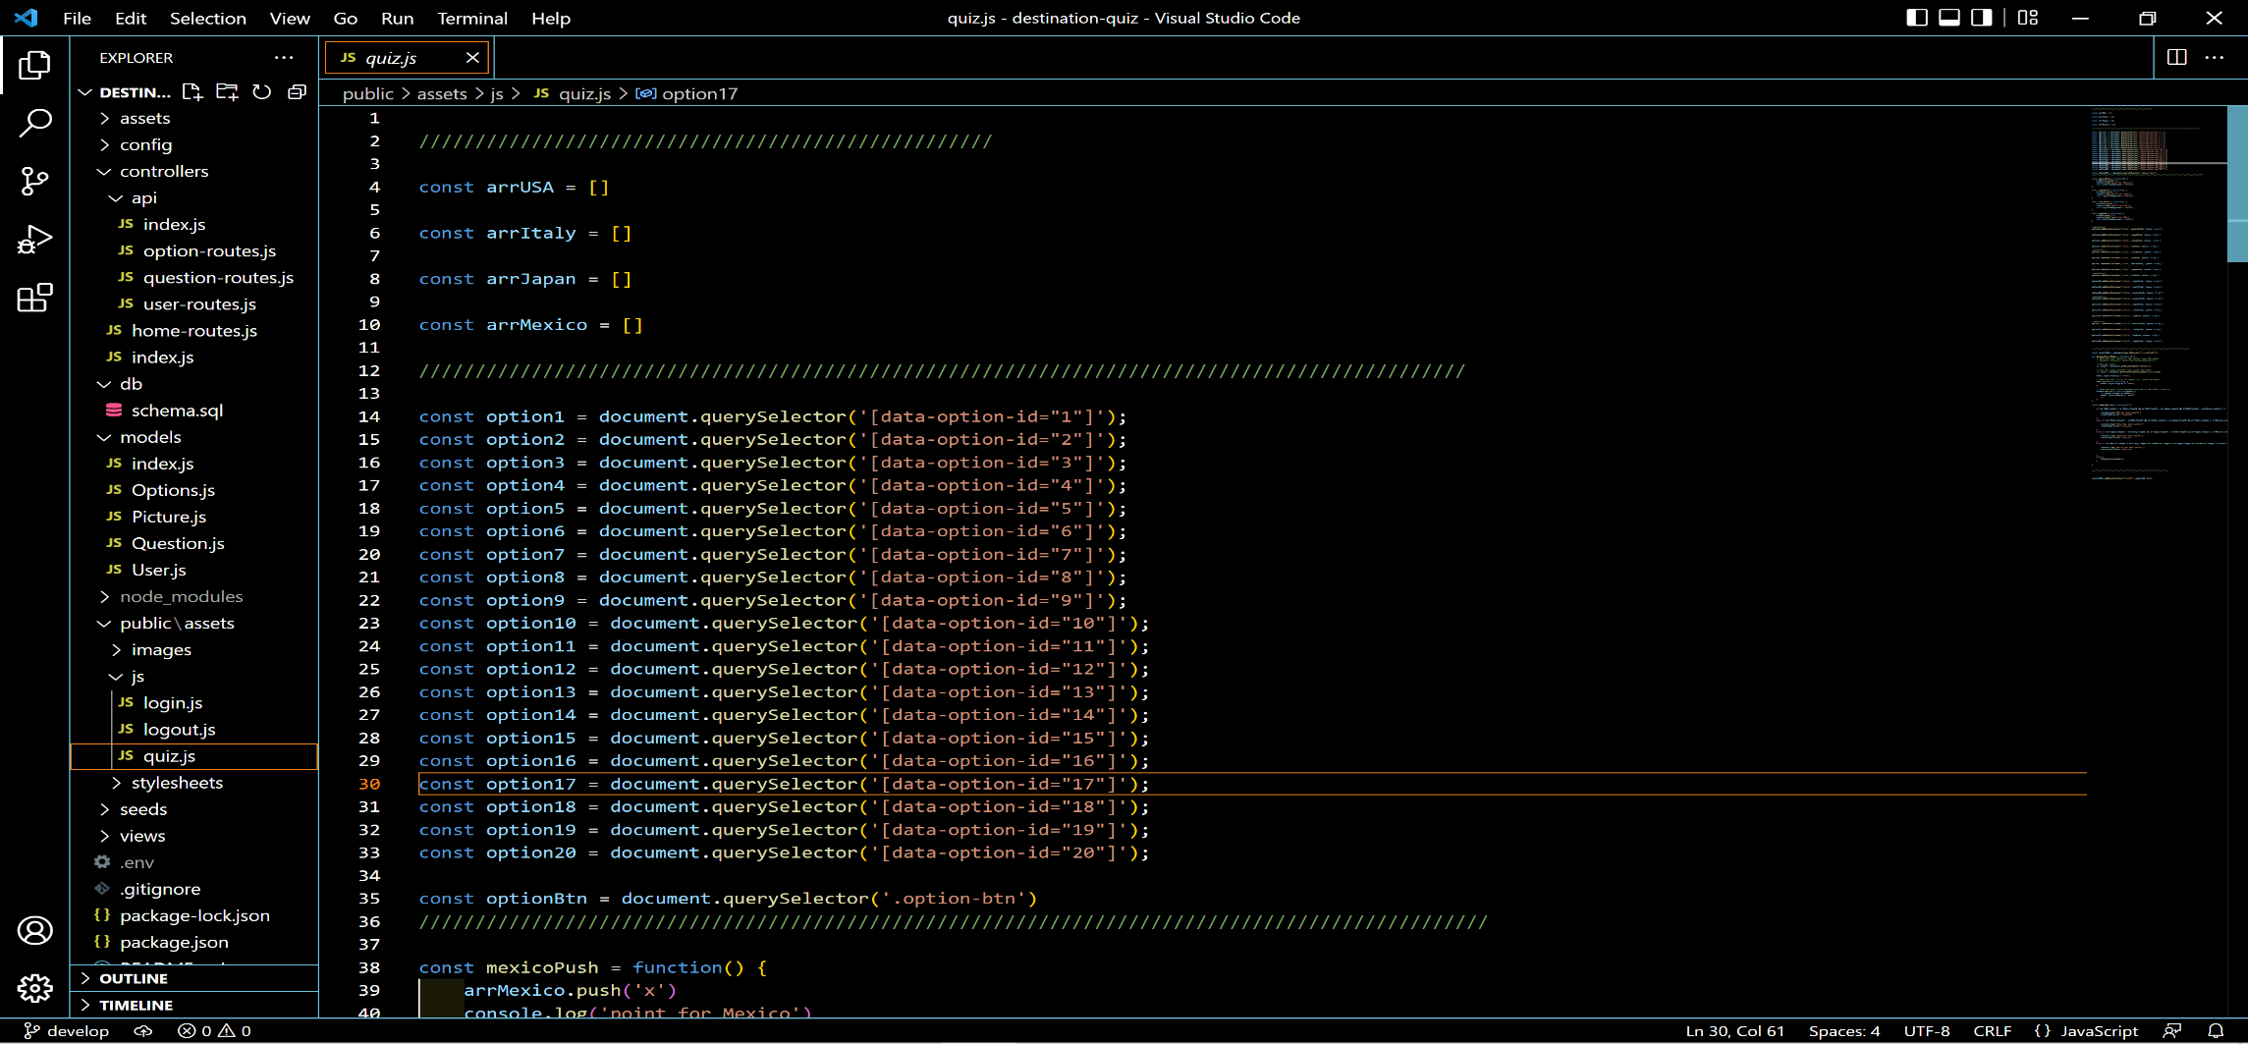
Code Highlights

Slide 24
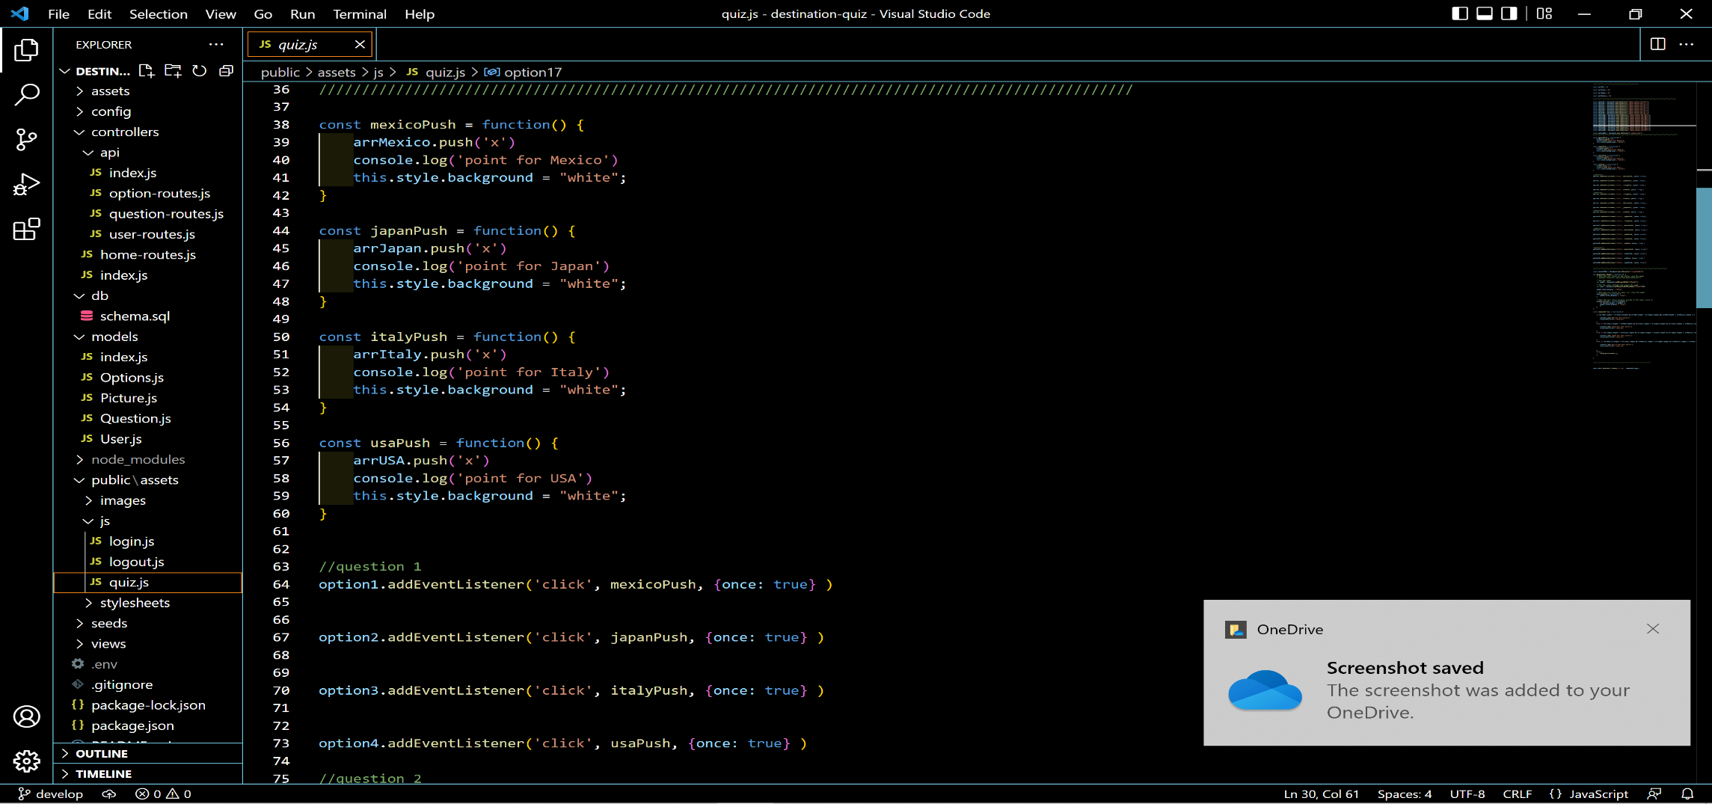
Code Highlights

Slide 25
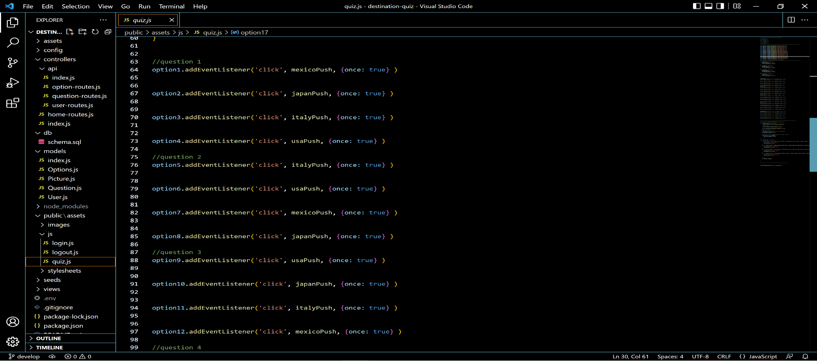
Code Highlights

Slide 26
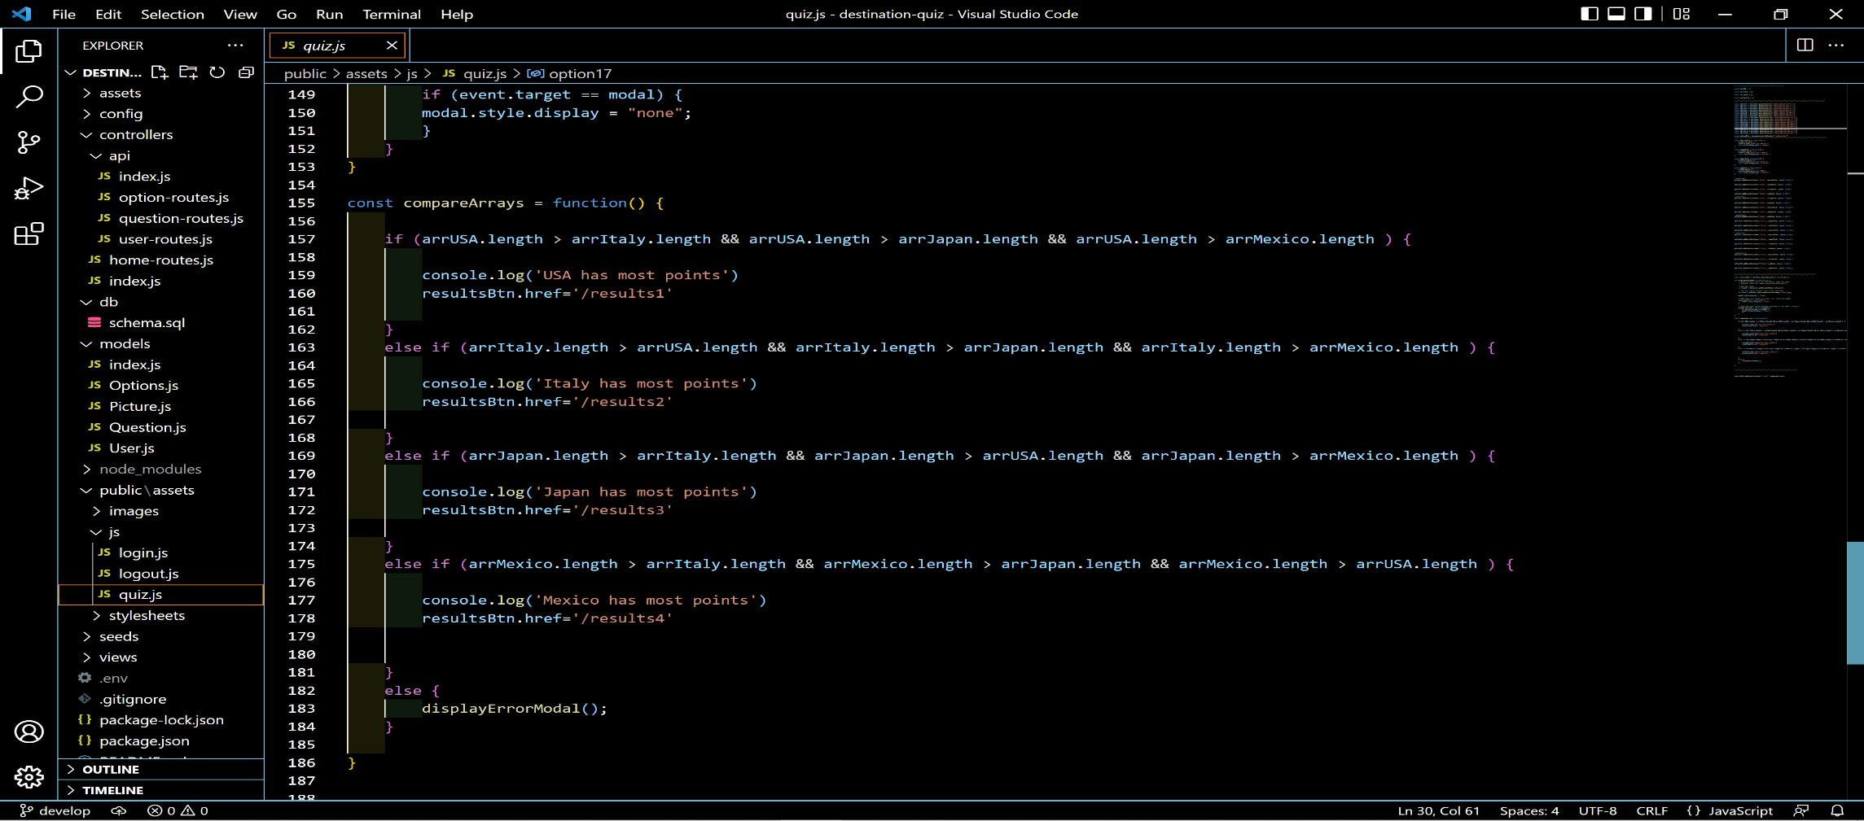
Code Highlights

Slide 27
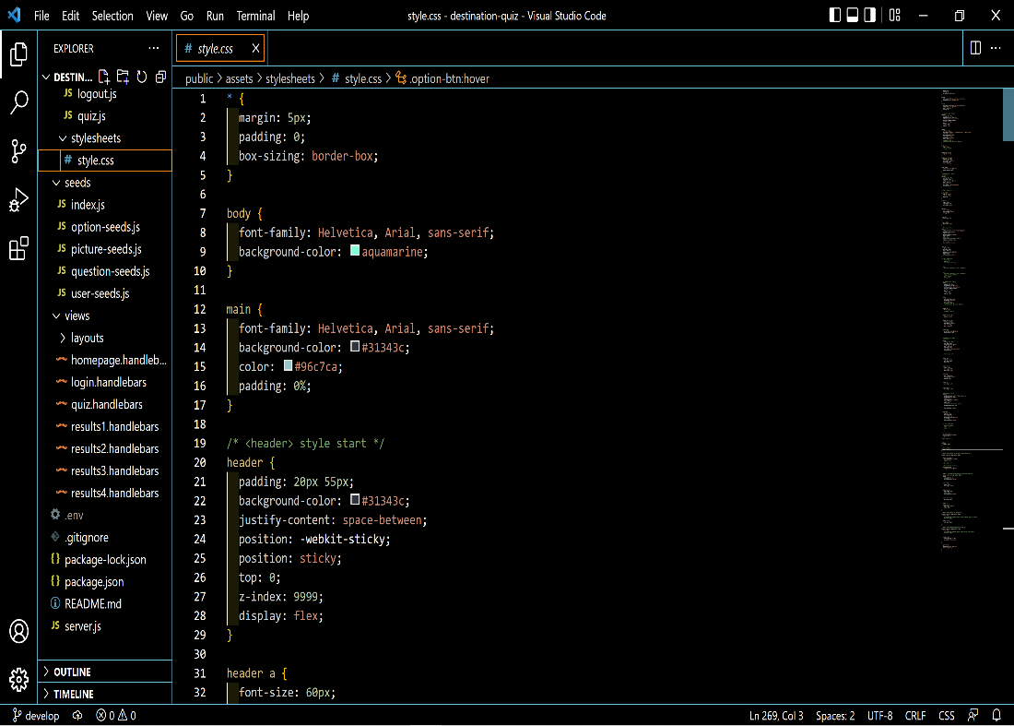
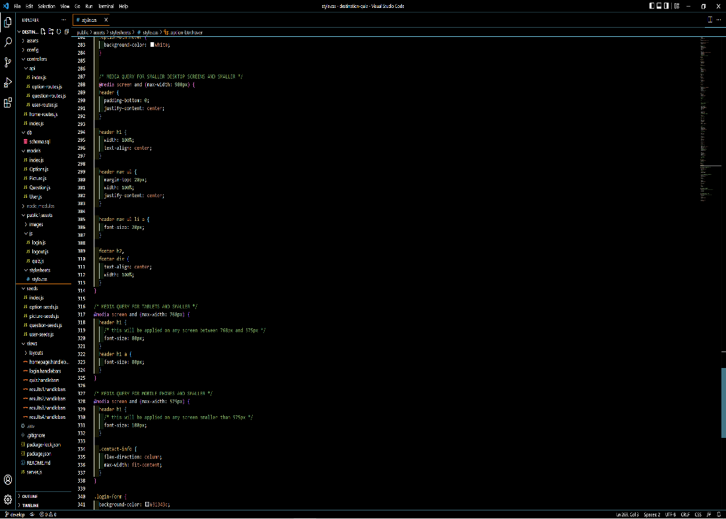
CSS – Bootstrap, Sticky Header, Media Responsive

Slide 28
Demo
Notes:
May require more than one slide

Slide 29
Future development
More interesting questions and more vacation spots
Once a country is chosen have resources for things to do, flights, and other itinerary items
See upcoming events at that location to determine travel dates
Page with facts about country selected (cultural and historical facts)
Notes:
May require more than one slide

Slide 30
Questions?

Slide 31
Thank you!
https://github.com/StephenWDickey/destination-quiz
QUESTIONS?

